Slide 1
Likelihood Ratio Tests
And
Model Selection
Notes:
a

Slide 2
Model selection — Why?
Understand which explanatory variables are important
Find evidence of relationship(s) between variable(s) and response
Quantify the effects of explanatory variables on the response
Use model to predict response values
Predict response at another location or time

Slide 3
Inference, Estimation, Prediction
Understand which explanatory variables are important
Find evidence of relationship(s) between variable(s) and response
Quantify the effects of explanatory variables on the response
Use model to predict response values
Predict response at another location or time

Slide 4
Model selection — Why?
Q: Why not just include all explanatory variables?
A: Extra predictors cost precision, and they are almost always correlated.
Too many predictors relative to sample size…
fits noise as if it were signal (overfitting), so out-of-sample prediction gets worse;
spends degrees of freedom, inflating variance of estimates and predictions.
Correlation among explanatory variables (collinearity)…
inflates standard errors, so real effects are hard to detect;
makes individual coefficients unstable and hard to interpret — estimates are imprecise.

Slide 5
Fit?
Compare “fit” of different models
Define “fit” — (maximum) likelihood?
Increases when adding more variables
Need to penalise fit somehow (to avoid overfitting)
Choice between different approaches reflects choice of penalty
sometimes just strength of penalty
Three ways of comparing likelihoods…

Slide 6
Definitions: AIC, BIC, LRT
AIC — Akaike’s Information Criterion
AIC = −2 log ℓ(θ̂) + 2p
AIC_{C} — corrected for small samples
AIC_{C} = AIC + 2p(p+1) / (n − p − 1)
BIC — Bayesian Information Criterion
BIC = −2 log ℓ(θ̂) + p log n
LRT — Likelihood Ratio Test
−2 log ℓ(θ̂₁) + 2 log ℓ(θ̂₂) ~ χ² with df = p₂ − p₁
Reduced
(simpler)
Full
(complex)

Slide 7
Hypothesis Tests to Compare Models (not parameters)
One can use the likelihood ratio test to compare two models when
both are based on the same data
one of the models is “nested” within the other
That is, one model is a special case with a parameter equal to a specific value (usually zero) from the more general model.

Slide 8
Nested Models
The following models are nested:
y = Time + Depth * Region
y = Depth * Region
The following models are not nested:
y = Time + Depth * Region
y = Temp + Depth * Region

Slide 9
Hypothesis Tests for Models
Model A nested within more general model B can be compared as follows:
H₀: Model A fits the data as well as Model B
(with fewer parameters)
H_{A}: Model A does not fit the data as well as Model B
(you need those extra parameters)
Fit models A and B and record:
the negative log-likelihood at the best fit
the number of parameters in models A and B, p_{A} and p_{B}.

Slide 10
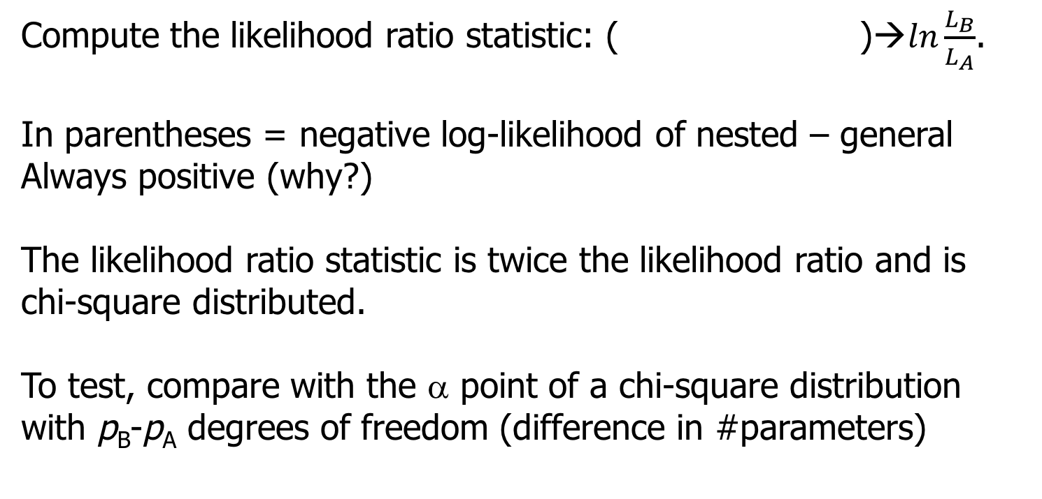
Hypothesis Tests for Models
Compute the likelihood ratio
( −ln L_{A} − (−ln L_{B}) )
If using lm or glm objects in R:
lrtest(full_model, reduced_model) from lmtest
anova(reduced, full, test = "Chisq") in base R

Slide 11
When is this useful rather than just interpreting coefficients?
Interpret coefficients when you're asking about individual parameters. Use a likelihood ratio test (LRT) when you're asking about a model or a collection of parameters.
No Need for LRT, just interpret coefficients
glm(count ~ temperature + elevation, family = poisson)
Suppose treatment has 5 levels. How do you know if the model is better with treatment? Use LRT
glm(count ~ treatment, family = poisson)
How do you know if the interaction term makes the model better? Use LRT
glm(count ~ treatment*temperature, family = poisson)

Slide 12
Usually the simpler model sets some parameters to zero, but null can be nonzero
You monitor an intersection for cars that run the red light. Based on 50 days of observation, you detect 30 days on which “light running” took place. You repeat the “experiment” after a red light camera is installed and now observe 10 days on which “running” occurred.
How do we know if there is a significant difference in the rate of running red lights after a camera is installed?

Slide 13
Example-I
Let us define P₁ as the probability of running the light before the
camera was installed and P₂ the probability after the camera
The Binomial likelihood function (ignoring the normalizing constant):
Model A: The probability of running the light has not changed
(P₁=P₂; The more specific model; you only need 1 parameter)
Model B: P₁ may differ from P₂.
(The more general model – more parameters)
L = P₁³⁰ (1 − P₁)²⁰ P₂¹⁰ (1 − P₂)⁴⁰

Slide 14
Example-II
Summary for this example
P̂₁
P̂₂
−ln L
Model A: 0.4 0.4 67.30
Model B: 0.6 0.2 58.67
The difference between the negative log likelihoods
67.3 - 58.7 = 8.6
Twice this difference is 17.2
Is this significant given the difference in parameters is 1?

Slide 15
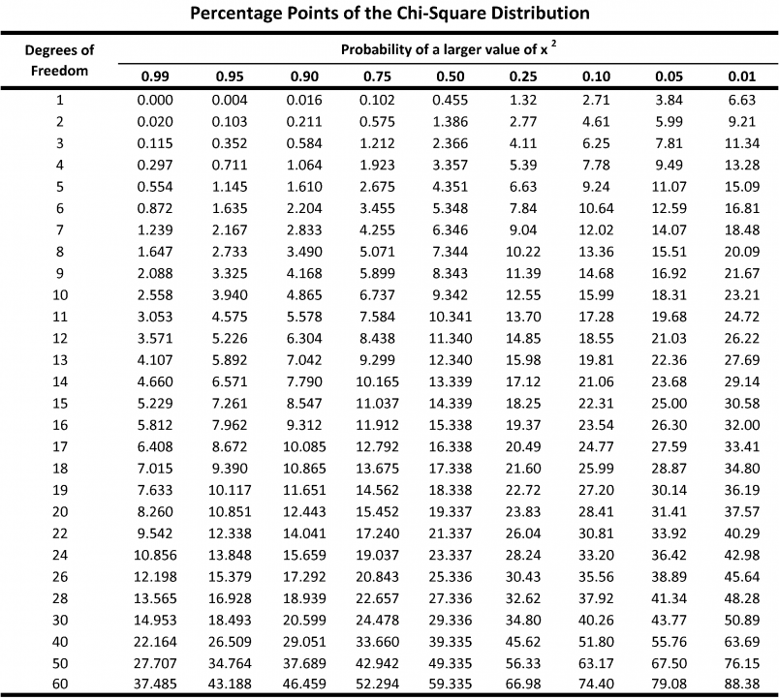
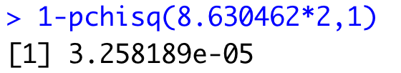
Example-II
The difference between the negative log likelihoods is 8.6 – is
this significant given the difference in parameters is 1?
2*8.6=17.2, compare to chisq distribution with one d.f
REJECT THE NULL
That the one parameter model fits the data. Much better to use two parameters, indicating that the probability of running the red light has changed!

Slide 16
Likelihood ratio test can typically only be applied to nested models
“Information theoretic” approaches (e.g. AIC, BIC) can be used to compare non-nested models.
Models with smaller values of AIC or BIC are “better”, or “have more support” or “are more parsimonious”, but we’ll dig into what this really means for AIC and BIC.

Slide 17
Information Theoretic Criteria for Model Selection
LRT = −2 log_{e} ( ℒ_{s}(θ^{ˆ}) / ℒ_{g}(θ^{ˆ}) )
Compare to chi.sq distribution with degrees of freedom = difference in # parameters
Look familiar?
AIC_{i} = −2 log L_{i} + 2 p_{i}
BIC_{i} = −2 log L_{i} + p_{i} log n
AIC and BIC are meaningless on their own, but models with lower values are more parsimonious (i.e. supported). They balance better fit with more parameters. This is exactly what the likelihood ratio test does.

Slide 18
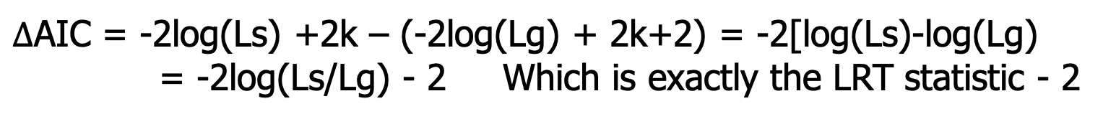
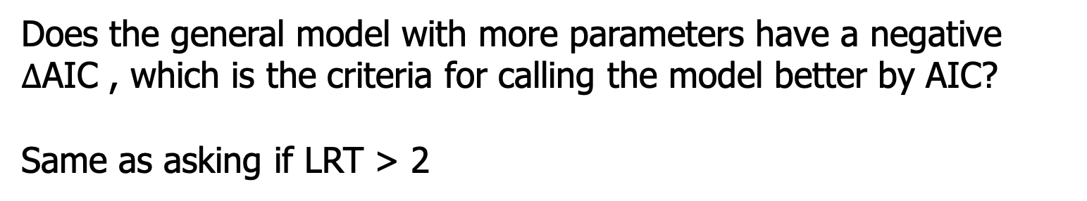
Information Theoretic Criteria for Model Selection
LRT = −2 log_{e} ( ℒ_{s}(θ^{ˆ}) / ℒ_{g}(θ^{ˆ}) )
Compare to chi.sq distribution with degrees of freedom = difference in # parameters
compare two models with k parameters and with k+1

Slide 19
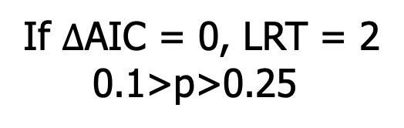
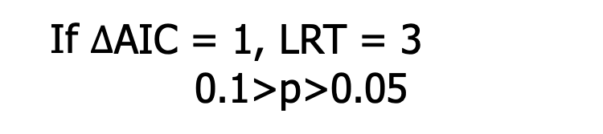
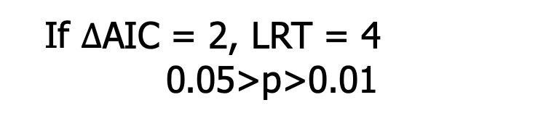
If 1 parameter separate the model. AIC likes bigger models
“the extra parameter is worth it”
Convention within <2 AIC units are “considered competitive”, and this is approximately the same as frequentist model selection using LRT

Slide 20
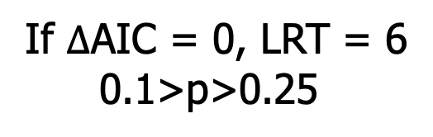
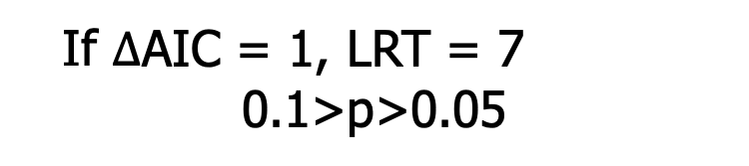
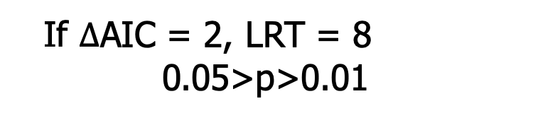
What if 3 parameters separate the model? AIC likes bigger models
(reject the null that the parameters equal 0)
2 deltaAIC still equivalent to p = 0.05

Slide 21
Most common mistake in ecology!
Interpretation of relative AIC is not symmetric
THE CLAIM
Two models within 2 AIC units of each other are “competitive.”
WHY IT FAILS
Within 2 units is exactly where a pure-noise parameter always lands. It is the floor, not evidence.
ΔAIC = AIC(complex) − AIC(simple) = 2 − χ²₁
hard ceiling at ΔAIC = 2 ▼
χ²₁ = likelihood-ratio statistic for the one extra parameter
Real evidence
χ²₁ > 4, p < 0.05
Weak
2 < χ²₁ < 4
No evidence
0 < χ²₁ < 2
cannot happen
-6
-4
-2
0
+2
+4
◀ complex model better
complex model worse ▶
Complex model wins by more than 2 units. The only zone that is evidence.
Complex model ahead, but by less than 2.
Complex model behind. Pure noise lands here every time.
Because χ²₁ is never negative, ΔAIC can never exceed 2. Landing “within 2” is guaranteed by the arithmetic, not earned by the data.
On average χ²₁ = 1, so a useless parameter typically sits about 1 AIC unit behind — and 16% of the time χ²₁ exceeds 2, so it takes the lower AIC outright.

Slide 22
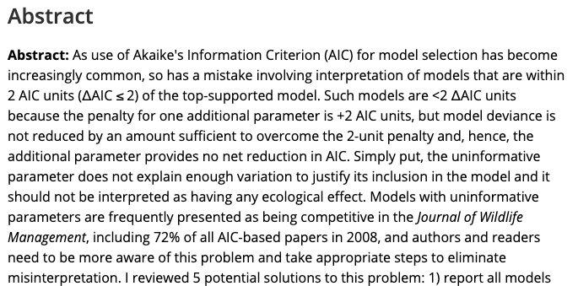
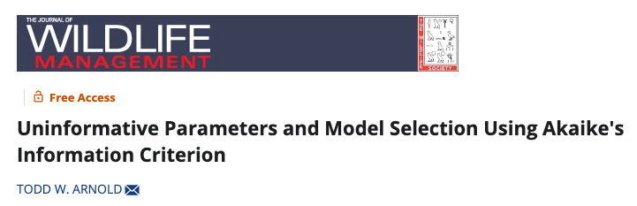
3700 Citations!
72% of all papers incorrectly interpret uninformative parameters!

Slide 23
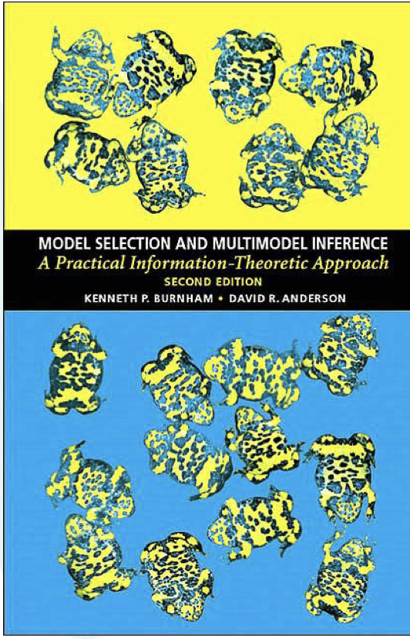
The Cult of AIC
Burnham & Anderson (2002)

Slide 24
Two key questions
“Always use AIC for model selection or model comparison”:
Is this instruction correct?
Why is it wrong?
From statisticians Mark Brewer and Adam Butler

Slide 25
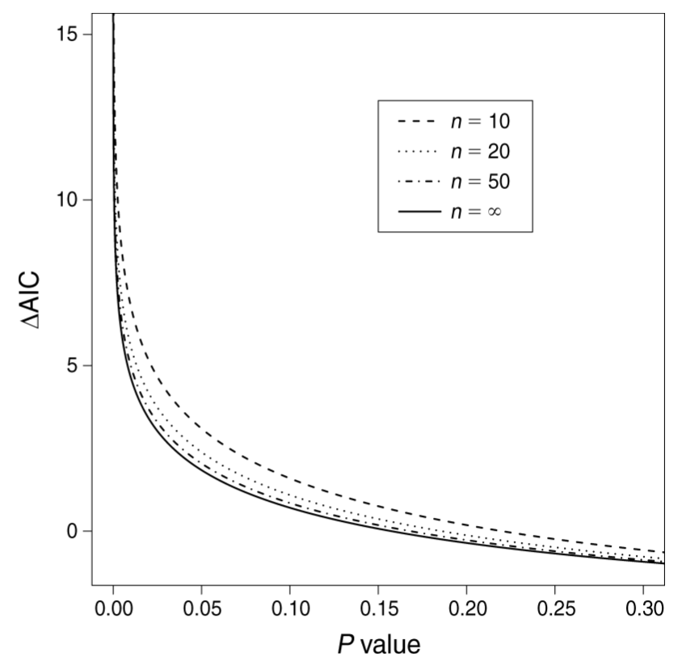
AIC and p-values
From Murtaugh Ecology (2014), Fig. 2:
Direct comparison
Two models, differ by one parameter

Slide 26
Why does the cult of AIC hate p-values?
P < 0.05 is an arbitrary threshold
But ⍙AIC < 2 is as well
AIC doesn’t suffer from Type I error or problems with autocorrelation
This is just wrong, as we will see by simulation. Making inference by AIC has MUCH MORE Type I error
P-values don’t tell us how important an effect is – i.e. whether the effect is biologically significant. Use effect sizes and confidence intervals instead
AIC doesn’t tell you that either. And I notice big tables full of models with no effect sizes or R², sometimes without even an intercept only model. What if all the models are terrible?
We always need effect sizes for inference. These are the most important part of the science!
But let’s remember how confidence intervals and p-values are related

Slide 27
Confidence intervals and p-values
Estimate and 95% CI. What is p?
Estimate and 99% CI. What is p?
-3 -2 -1 0 1 2 3
Effect sizes and p tell you the same thing as effect sizes and CIs!

Slide 28
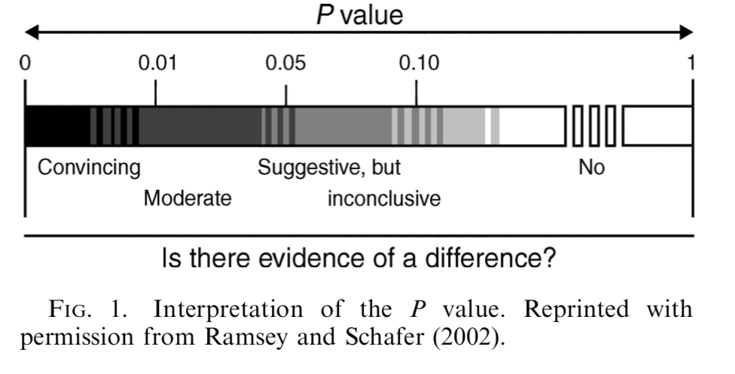
P-values should be interpreted on a continuum. Not a step function at 0.05. AIC should be interpreted in the same way!
deltaAIC=2
deltaAIC=7

Slide 29
So why use AIC?
It is easy to assess non-nested models of highly variable structure.
It is good for selecting models for prediction
But it is widely used for inference, resulting in more Type I error
Often used incorrectly, resulting in more error (more on this later)

Slide 30
Why did AIC take over wildlife science?
Aggressive marketing of the method by Burnham and Anderson, who were in Fisheries and Wildlife and “wrote the book”
People adopt new statistical methods, then find the holes, and then the pendulum swings back
It feels rigorous because you have to run so many models
People like ranking things

Slide 31
AIC in practice…
Var 1 | Var 2 | Var 3 | Var 4 | Var 5 | AIC | ΔAIC | Weight
 | -0.539 (± 0.244) |  | -0.602 (± 0.190) |  | 1789.73 | 0.00 | 0.26
 | -0.674 (± 0.336) |  | -0.609 (± 0.192) | 0.173 (± 0.295) | 1791.38 | 1.65 | 0.12
 | -0.544 (± 0.245) | 0.003 (± 0.008) | -0.566 (± 0.214) |  | 1791.60 | 1.86 | 0.10
-0.090 (± 0.333) | -0.541 (± 0.244) |  | -0.574 (± 0.217) |  | 1791.66 | 1.93 | 0.10
 |  |  | -0.641 (± 0.201) |  | 1792.23 | 2.50 | 0.08
-0.070 (± 0.335) | -0.670 (± 0.336) |  | -0.586 (± 0.220) | 0.167 (± 0.296) | 1793.34 | 3.61 | 0.04
 |  |  | -0.622 (± 0.198) | -0.212 (± 0.222) | 1793.34 | 3.61 | 0.04
 | -0.662 (± 0.344) | 0.001 (± 0.008) | -0.591 (± -0.591) | 0.155 (± 0.316) | 1793.35 | 3.62 | 0.04
Which is the top model? Which models are competitive?

Slide 32
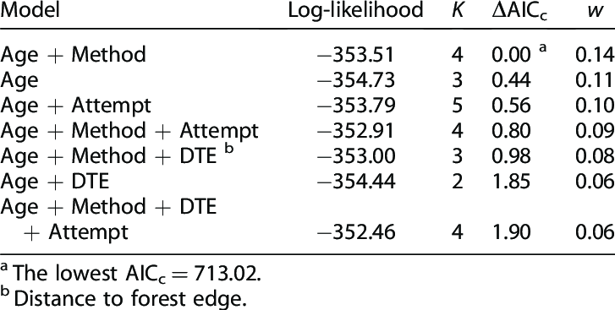
AIC in practice
For small sample sizes, AIC is biased and so people use AICc. AICc is treated as “corrected AIC” and converges to AIC for large n.
Model weights. Each model i of R is weighted based on its deltaAIC.
Variables included with lots of model weight considered important.
Model weight used for averaging across models for prediction
Both deltaAIC and weights depend on model set
AICc = AIC + (2k² + 2k) / (n − k − 1)
w_{i} = exp(−0.5 Δ_{i}) / Σ_{r=1} ^{R} exp(−0.5 Δ_{r})
Why would I hate this table as the only presentation of results?

Slide 33
Most common mistake in ecology!
AIC_{i} = −2 log L_{i} + 2 p_{i}
Interpretation of relative AIC is not symmetric
If a more complex model has higher AIC but less than 2 units, it is NOT competitive
Penalty for adding parameter is 2 units and fit improves with complexity, so models with random data as predictor will be within 2 AIC.
The 2 AIC convention is about whether a more complex model with lower AIC is better enough relative to simpler model

Slide 34
3700 Citations!
72% of all papers incorrectly interpret uninformative parameters!

Slide 35

Best recent paper as a resource to stop doing dumb stuff with AIC

Slide 36
B & A recipe for modelling
Procedure for model selection:
Decide on scientific questions to answer
Define small candidate set of models
Fit models, calculate AIC, find “best” model
Use threshold on ΔAIC to determine set of “plausible” models
Calculate model weights via ΔAIC
(Assess variable importance using weights)

Slide 37
Burnham and Anderson did not advocate model dredging (fitting all/many combinations of predictors)
If you look at many models, you will have many Type I errors leading to “overfitting”.
But did ecologists listen to B&A and construct sensible model sets?
Hell no
Do ecologists even think about whether the purpose of modeling is inference or prediction?
Also no
“An investigator with, say, 10 explanatory variables cannot expect to learn much from his data and a multiple linear regression analysis unless there is some substantial supporting science that can be used to help narrow the number of models to consider. In this example, there would be 1,024 models (many more if transformations or interaction terms were allowed), and over-ﬁtting would surely be a serious risk. The analysis, by whatever method, should probably be considered exploratory and the results used to design further data gathering leading to a more conﬁrmatory analysis, based on some a priori considerations” (Burnham and Anderson 2002:85)

Slide 38


Slide 39
Then what about BIC? Is it just a similar alternative?
AIC_{i} = −2 log L_{i} + 2 p_{i}
BIC_{i} = −2 log L_{i} + p_{i} log n
The penalty in BIC increases with the sample size
AIC retains more complex models than BIC or p-values
AIC chooses the model that gives the best prediction. It is efficient for prediction.
BIC chooses the “correct” model if it is in the set (asymptotically).

Slide 40
AIC vs BIC
“Theoretically, AIC is optimal in the sense of minimizing the mean square error of predictions, whereas a competing metric, the Bayesian Information Criterion (BIC; Schwarz 1978), is consistent – that is, it will tend to select the ‘true’ model as the sample size increases to infinity.”
AIC is asymptotically equivalent to leave-one-out crossvalidation (prediction), and BIC is most similar to inference (p-values)

Slide 41
Method | Primary purpose | Requires nested models? | Complexity penalty | Produces p-value?
Likelihood Ratio Test (LRT) | Test a specific null hypothesis | Yes | compares improvement in likelihood to chi^2 distribution | Yes
AIC | Select the model expected to predict new data best | No | 2 AIC units per additional parameter | No
BIC | Select the simplest plausible data-generating model | No | Log(n) BIC units per additional parameter | No

Slide 42
Crossvalidation: Split data, train model, compare predictions to actual using test data. Repeat.
k-fold crossvalidation
Leave-one-out (n-fold crossvalidation)
Dataset
Train
Test

Slide 43
If the goal is prediction, is a linear model the right tool?
Cross-validation asks the right question: how well does this model predict data it has never seen?
But it can only compare the models you wrote down — and every one of them is a straight-line combination of the terms you chose.
Ecological responses are often nonlinear, full of thresholds, and full of interactions we would never think to write down.
When prediction is the goal, there are tools built for that job. You should know they exist.

Slide 44
What a tree actually does
Response: juvenile coho density (fish per 100 m²). Predictors: stream temperature, large wood, canopy cover.
Temperature < 16.5 °C
yes
no
Large wood ≥ 8 pieces
Canopy cover ≥ 45%
yes
no
yes
no
24.3
n = 31
11.6
n = 24
7.2
n = 38
2.1
n = 27
Every observation lands in one leaf; the prediction is the mean of the training data in that leaf.
The wood split applies only in cold streams — an interaction nobody had to specify.

Slide 45
From one tree to many
A single tree is easy to read, but unstable — change a few data points and the splits change.
So we use many trees instead of one. Two versions of this idea are everywhere in ecology:
Random forests: grow hundreds of trees on resampled data, then average them.
Boosted regression trees: add trees one at a time, each improving on the last.
What you get back is a prediction, not an equation to interpret.

Slide 46
Two ways to use many trees
Random forest: many trees, averaged
Boosted trees: many trees, added up
Full dataset
Tree 1 makes a rough prediction
Tree 1
Tree 2
Tree 3
Tree 2 fixes what Tree 1 got wrong
Tree 3 fixes what is still wrong
Average all the trees
Prediction = all the trees added up
Each tree sees a different random slice of the data. Averaging them gives a steadier prediction than any single tree.
No single tree is very good. Together they build up a prediction that fits patterns no straight line could.

Slide 47
Which one do you want?
Reach for trees when…
A map or a forecast is the actual deliverable.
You have many predictors and little idea which matter.
You expect thresholds or interactions you cannot specify.
You want a check on whether your GLM is missing something.
Stay with a GLM when…
You need an effect size with a confidence interval.
You have a hypothesis to test.
You are asking why, not just what.
You need to predict beyond the range of your data.

Slide 48
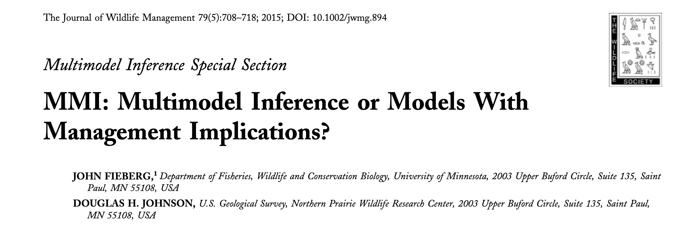
Don’t take my word for it…
One way to avoid some of the problems associated with model selection is to “just say no” to data-driven model selection—in other words, ﬁt a single pre-speciﬁed model, one in which all explanatory variables are chosen prior to looking at their relationship with the response variable, and then use this model for inference (Harrell 2001, Babyak 2004, Whittingham et al. 2006, Guidice et al. 2012).

Slide 49
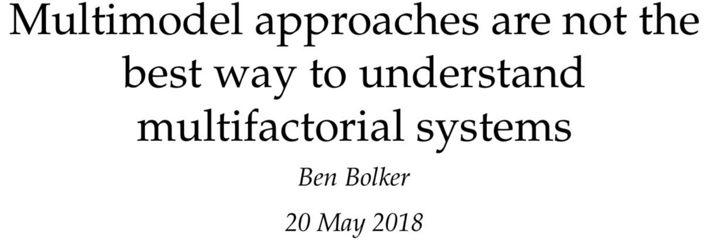
Don’t take my word for it…
“If researchers want to accurately estimate the strength of multiple competing ecological processes along with reliable confidence intervals, their best hope is to use full (maximal) statistical models after making principled, a priori decisions about which predictors to include. “
Left as a preprint for years until Bolker finally submitted it to a journal after we chatted about this problem

Slide 50
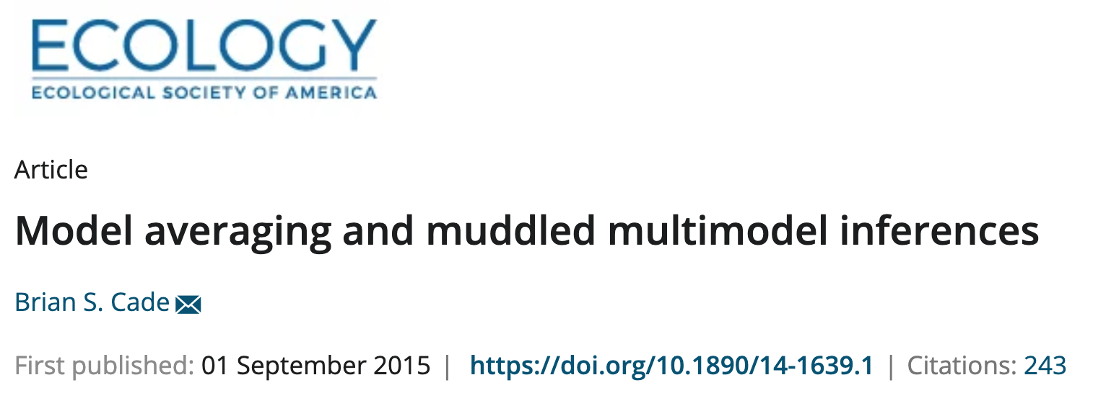
Don’t take my word for it…
The associated sums of AIC model weights recommended to assess relative importance of individual predictors are really a measure of relative importance of models, with little information about contributions by individual predictors compared to other measures of relative importance based on effects size or variance reduction.
The standardized estimates or equivalently the t statistics on unstandardized estimates also can be used to provide more informative measures of relative importance than sums of AIC weights. Finally, I illustrate how seriously compromised statistical interpretations and predictions can be for all three of these flawed practices by critiquing their use in a recent species distribution modeling technique developed for predicting Greater Sage‐Grouse (Centrocercus urophasianus) distribution in Colorado, USA. These model averaging issues are common in other ecological literature and ought to be discontinued if we are to make effective scientific contributions to ecological knowledge and conservation of natural resources.

Slide 51
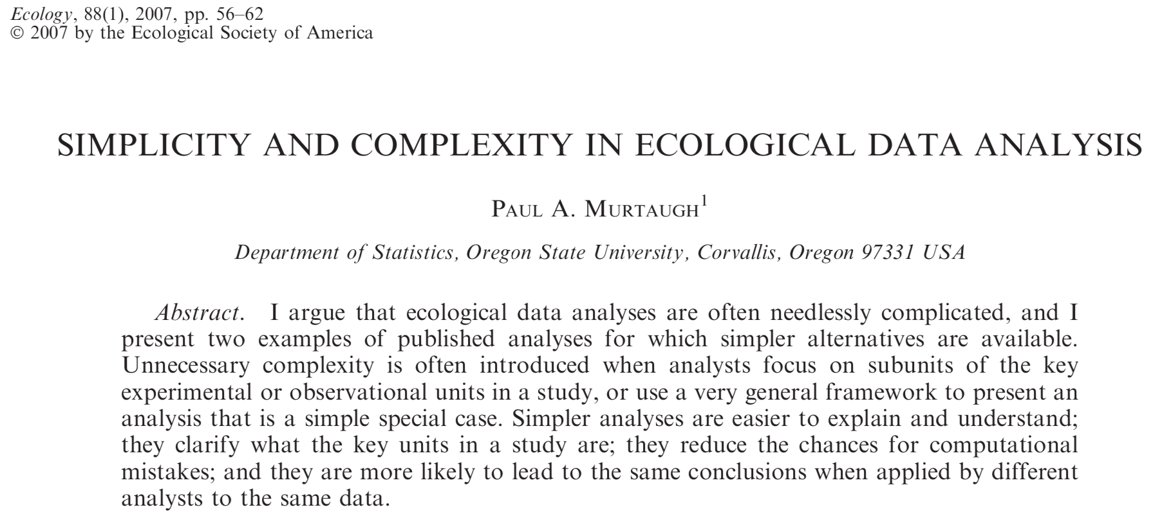
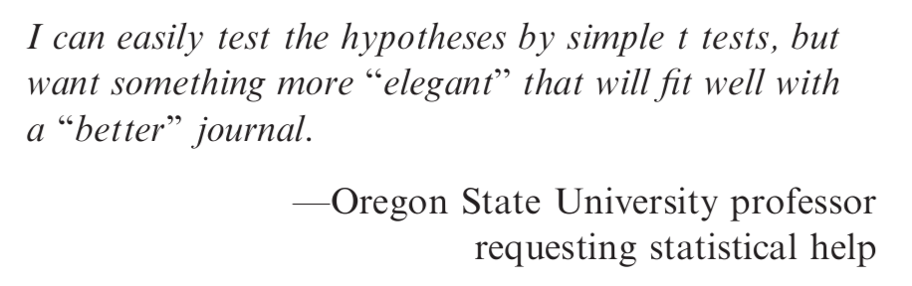

Slide 52
Recommended Readings
Aho et al. 2014 “Model selection for ecologists: The worldviews of AIC and BIC”. Ecology
Shmueli 2010 “To explain or to predict”. Statistical Science
Murtaugh 2007 “Simplicity and complexity in ecological data analysis”. Ecology
Arnold 2010 “Uninformative Parameters and Model Selection Using Akaike's Information Criterion” JWM
”Murtaugh 2014 “In defense of P-values”. Ecology
Fieberg and Johnson 2015 “MMI: Multimodel Inference or Models With Management Implications?”. Journal of Wildlife Management
Sutherland et al. 2023 “Practical advice on variable selection and reporting using Akaike information criterion. Proceedings B
Bolker 2024 “Multimodel Approaches Are Not the Best Way to Understand Multifactorial Systems”. Entropy

